Slide 1
Communication and Information Technology
Chapter
11

Slide 2
L E A R N I N G O U T L I N E
Follow this Learning Outline as you read and study this chapter.
Understanding Communications
  Differentiate between interpersonal and organizational communication.
  Discuss the functions of communication.
The Process of Interpersonal Communications
  Explain all the components of the communication process.
  List the communication methods managers might use.
  Describe nonverbal communication and how it takes place.
  Explain the barriers to effective interpersonal communication and how to overcome them.

Slide 3
L E A R N I N G O U T L I N E (cont’d)
Follow this Learning Outline as you read and study this chapter.
Organizational Communication
  Explain how communication can flow in an organization.
  Describe the three common communication networks.
  Discuss how managers should handle the grapevine.
Understanding Information Technology
  Describe how technology affects managerial communication.
  Define e-mail, instant messaging, blogs and wikis, voice-mail, fax, EDI, teleconferencing, videoconferencing, web conferencing, intranet, and extranet.
  Explain how information technology affects organizations.

Slide 4
L E A R N I N G O U T L I N E (cont’d)
Follow this Learning Outline as you read and study this chapter.
Communication Issues in Today’s Organization
  Discuss the challenges of managing communication in an Internet world.
  Explain how organizations can manage knowledge.
  Explain why communicating with customers is an important managerial issue.
  Explain how political correctness is affecting communication.

Slide 5
What Is Communication?
Communication
  The transfer and understanding of meaning.
    Transfer means the message was received in a form that can be interpreted by the receiver.
    Understanding the message is not the same as the receiver agreeing with the message.
  Interpersonal Communication
    Communication between two or more people
  Organizational Communication
    All the patterns, network, and systems of communications within an organization

Slide 6
Four Functions of Communication
Control
Motivation
Functions of
Communication
Information
Emotional
Expression

Slide 7
Functions of Communication
Control
  Formal and informal communications act to control individuals’ behaviors in organizations.
Motivation
  Communications clarify for employees what is to done, how well they have done it, and what can be done to improve performance.

Slide 8
Functions of Communication (cont’d)
Emotional Expression
  Social interaction in the form of work group communications provides a way for employees to express themselves.
Information
  Individuals and work groups need information to make decisions or to do their work.

Slide 9
Interpersonal Communication
Message
  Source: sender’s intended meaning
Encoding
  The message converted to symbolic form
Channel
  The medium through which the message travels
Decoding
  The receiver’s retranslation of the message
Noise
  Disturbances that interfere with communications

Slide 10
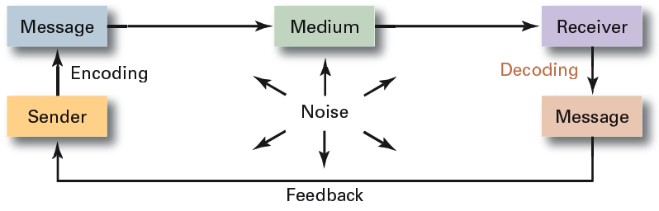
Exhibit 11–1 The Interpersonal Communication Process

Slide 11
Distortions in Communications
Message Encoding
  The effect of the skills, attitudes, and knowledge of the sender on the process of encoding the message
  The social-cultural system of the sender
The Message
  Symbols used to convey the message’s meaning
  The content of the message itself
  The choice of message format
  Noise interfering with the message

Slide 12
Distortions in Communications (cont’d)
The Channel
  The sender’s choice of the appropriate channel or multiple channels for conveying the message
Receiver
  The effect of skills, attitudes, and knowledge of the receiver on the process of decoding the message
  The social-cultural system of the receiver
Feedback Loop
  Communication channel distortions affecting the return message from receiver to sender

Slide 13
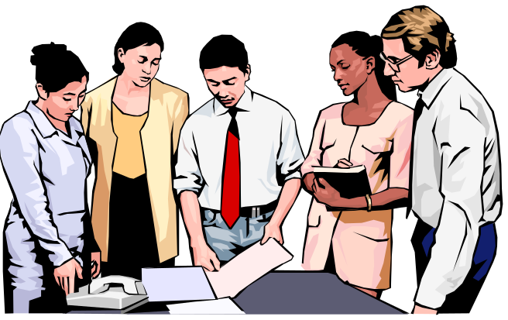
Interpersonal Communication Methods
Face-to-face
Telephone
Group meetings
Formal presentations
Memos
Traditional Mail
Fax machines
Employee publications
Bulletin boards
Audio- and videotapes
Hotlines
E-mail
Computer conferencing
Voice mail
Teleconferences
Videoconferences

Slide 14
Evaluating Communication Methods
Feedback
Complexity capacity
Breadth potential
Confidentiality
Encoding ease
Decoding ease
Time-space constraint
Cost
Interpersonal warmth
Formality
Scanability
Time consumption

Slide 15
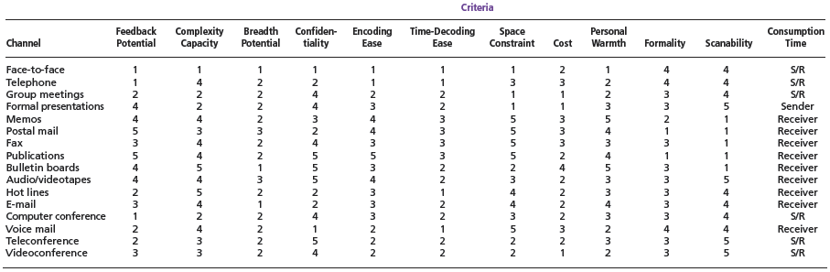
Exhibit 11–2 Comparison of Communication Methods
Note: Ratings are on a 1–5 scale where 1 = high and 5 = low. Consumption time refers to who controls the reception of communication. S/R means the sender and receiver share control.
Source: P. G. Clampitt, Communicating for Managerial Effectiveness (Newbury Park, CA: Sage Publications, 1991), p. 136.

Slide 16
Interpersonal Communication (cont’d)
Nonverbal Communication
  Communication that is transmitted without words.
    Sounds with specific meanings or warnings
    Images that control or encourage behaviors
    Situational behaviors that convey meanings
    Clothing and physical surroundings that imply status
  Body language: gestures, facial expressions, and other body movements that convey meaning.
  Verbal intonation: emphasis that a speaker gives to certain words or phrases that conveys meaning.

Slide 17
Interpersonal Communication Barriers
Filtering
National
Culture
Emotions
Language
Interpersonal Communication
Information
Overload
Defensiveness

Slide 18
Barriers to Effective Interpersonal Communication
Filtering
  The deliberate manipulation of information to make it appear more favorable to the receiver.
Emotions
  Disregarding rational and objective thinking processes and substituting emotional judgments when interpreting messages.
Information Overload
  Being confronted with a quantity of information that exceeds an individual’s capacity to process it.

Slide 19
Barriers to Effective Interpersonal Communication (cont’d)
Defensiveness
  When threatened, reacting in a way that reduces the ability to achieve mutual understanding.
Language
  The different meanings of and specialized ways (jargon) in which senders use words can cause receivers to misinterpret their messages.
National Culture
  Culture influences the form, formality, openness, patterns and use of information in communications.

Slide 20

Overcoming the Barriers to Effective Interpersonal Communications
Use Feedback
Simplify Language
Listen Actively
Constrain Emotions
Watch Nonverbal Cues

Slide 21
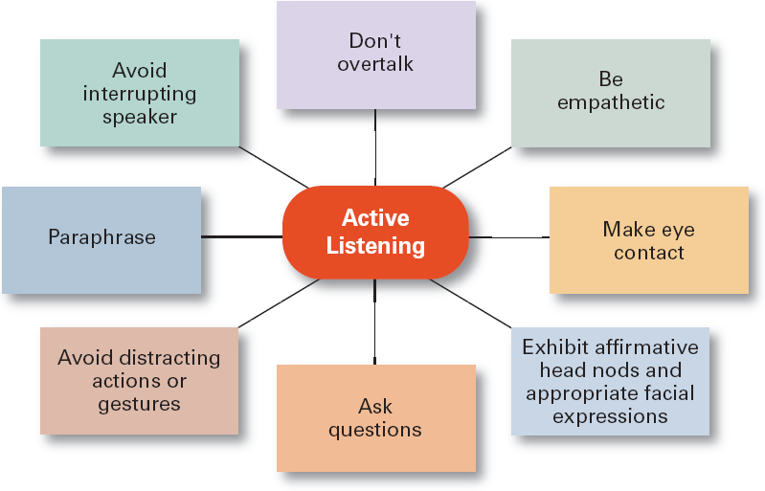
Exhibit 11–3 Active Listening Behaviors
Source: Based on P.L. Hunsaker, Training in Management Skills (Upper Saddle River, NJ: Prentice Hall, 2001).

Slide 22
Types of Organizational Communication
Formal Communication
  Communication that follows the official chain of command or is part of the communication required to do one’s job.
Informal Communication
  Communication that is not defined by the organization’s hierarchy.
    Permits employees to satisfy their need for social interaction.
    Can improve an organization’s performance by creating faster and more effective channels of communication.

Slide 23

Communication Flows
Diagonal
Upwa
r
d
Downwa
r
d
Lateral

Slide 24
Direction of Communication Flow
Downward
  Communications that flow from managers to employees to inform, direct, coordinate, and evaluate employees.
Upward
  Communications that flow from employees up to managers to keep them aware of employee needs and how things can be improved to create a climate of trust and respect.

Slide 25
Direction of Communication Flow (cont’d)
Lateral (Horizontal) Communication
  Communication that takes place among employees on the same level in the organization to save time and facilitate coordination.
Diagonal Communication
  Communication that cuts across both work areas and organizational levels in the interest of efficiency and speed.

Slide 26
Types of Communication Networks
Chain Network
  Communication flows according to the formal chain of command, both upward and downward.
Wheel Network
  All communication flows in and out through the group leader (hub) to others in the group.
All-Channel Network
  Communications flow freely among all members of the work team.

Slide 27
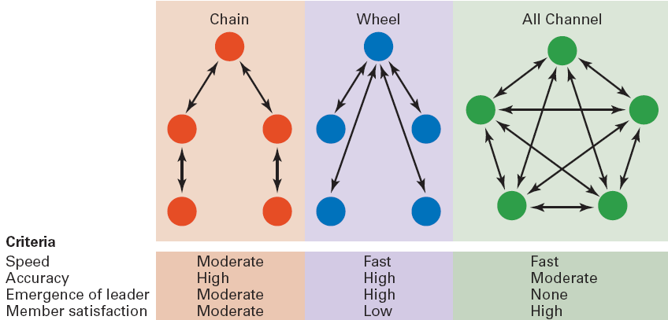
Exhibit 11–4 Three Common Organizational Communication Networks and How They Rate on Effectiveness Criteria

Slide 28
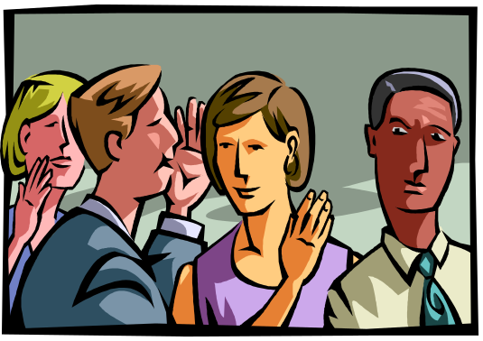
The Grapevine
An informal organizational communication network that is active in almost every organization.
  Provides a channel for issues not suitable for formal communication channels.
  The impact of information passed along the grapevine can be countered by open and honest communication with employees.

Slide 29
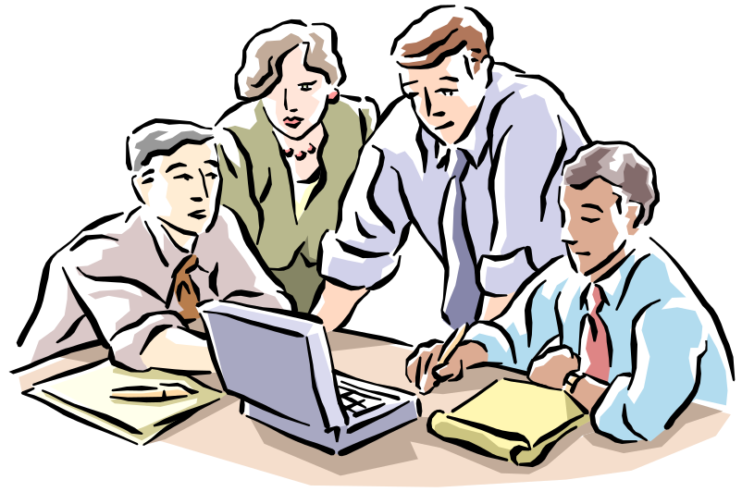
Understanding Information Technology
Benefits of Information Technology (IT)
  Increased ability to monitor individual and team performance
  Better decision making based on more complete information
  More collaboration and
  sharing of information
  Greater accessibility
  to coworkers

Slide 30

Information Technology (cont’d)
Networked Computer Systems
  Linking individual computers to create an organizational network for communication and information sharing.
E-mail
Instant messaging (IM)
Blogs
Wikis
Voice-mail
Fax machines
Electronic Data Exchange (EDI)
Teleconferencing
Videoconferencing
Web conferencing

Slide 31
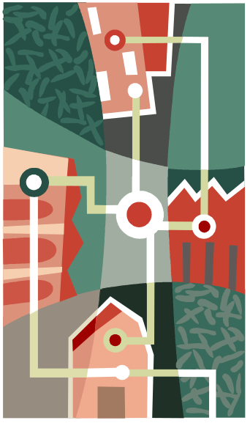
Information Technology (cont’d)
Types of Network Systems
  Intranet
    An internal network that uses Internet technology and is accessible only to employees.
  Extranet
    An internal network that uses Internet technology and allows authorized users inside the organization to communicate with certain outsiders such as customers and vendors.
  Wireless (WIFI) capabilities

Slide 32
How IT Affects Organization
Removes the constraints of time and distance
  Allows widely dispersed employees to work together.
Provides for the sharing of information
  Increases effectiveness and efficiency.
Integrates decision making and work
  Provides more complete information and participation for better decisions.
Creates problems of constant accessibility to employees
  Blurs the line between work and personal lives.

Slide 33

Current Communication Issues
Managing Communication in an Internet World
  Legal and security issues
    Inappropriate use of company e-mail and instant messaging
    Loss of confidential and proprietary information due to inadvertent or deliberate dissemination or to hackers.
  Lack of personal interaction
    Being connected is not the same as face-to-face contact.
    Difficulties occur in achieving understanding and collaboration in virtual environements.

Slide 34
Current Communication Issues
Being connected versus being concerned
  Managing Internet gripe sites as a valuable resource for unique insights into the organization.
    Employee complaints (“hot-button” issues)
    Customer complaints
  Responding to Internet gripe sites
    Recognized them as a valuable source of information.
    Post messages that clarify misinformation.
    Take action to correct problems noted on the site.
    Set up an internal gripe site.
    Continue to monitor the public gripe site.

Slide 35

Current Communication Issues (cont’d)
Managing the Organization’s Knowledge Resources
  Build online information databases that employees can access.
  Create “communities of practice” for groups of people who share a concern, share expertise, and interact with each other.

Slide 36
Communication and Customer Service
Communicating Effectively with Customers
  Recognize the three components of the customer service delivery process:
    The customer
    The service organization
    The service provider
  Develop a strong service culture focused on the personalization of service to each customer.
    Listen and respond to the customer.
    Provide access to needed service information.

Slide 37

“Politically Correct” Communication
Do not use words or phrases that stereotype, intimidate, or offend individuals based on their differences.
However, choose words carefully to maintain as much clarity as possible in communications.

Slide 38
Terms to Know
communication
interpersonal communication
organizational communication
message
encoding
channel
decoding
communication process
noise
nonverbal communication
body language
verbal intonation
filtering
selective perception
information overload
jargon
active listening
formal communication
informal communication
downward communication
upward communication

Slide 39
Terms to Know (cont’d)
lateral communication
diagonal communication
communication networks
grapevine
e-mail
instant messaging (IM)
blog
wiki
voice mail
fax
electronic data interchange (EDI)
teleconferencing
videoconferencing
web conferencing
intranet
extranet
communities of practice

